Slide 1
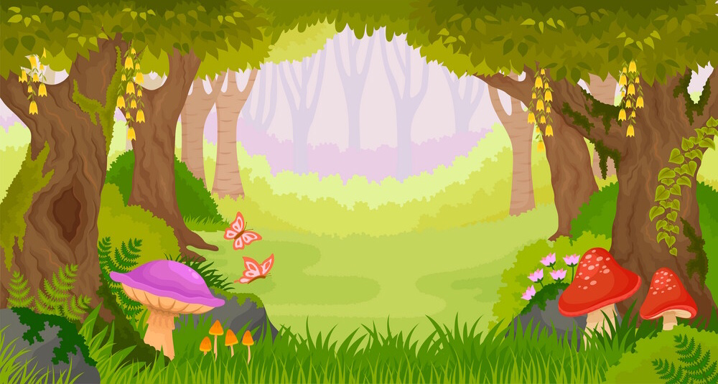
Different types of Trees
for 5-6 years old
Introduction – Task 1–Task 2– Evaluation– Conclusion– Credits

Slide 2
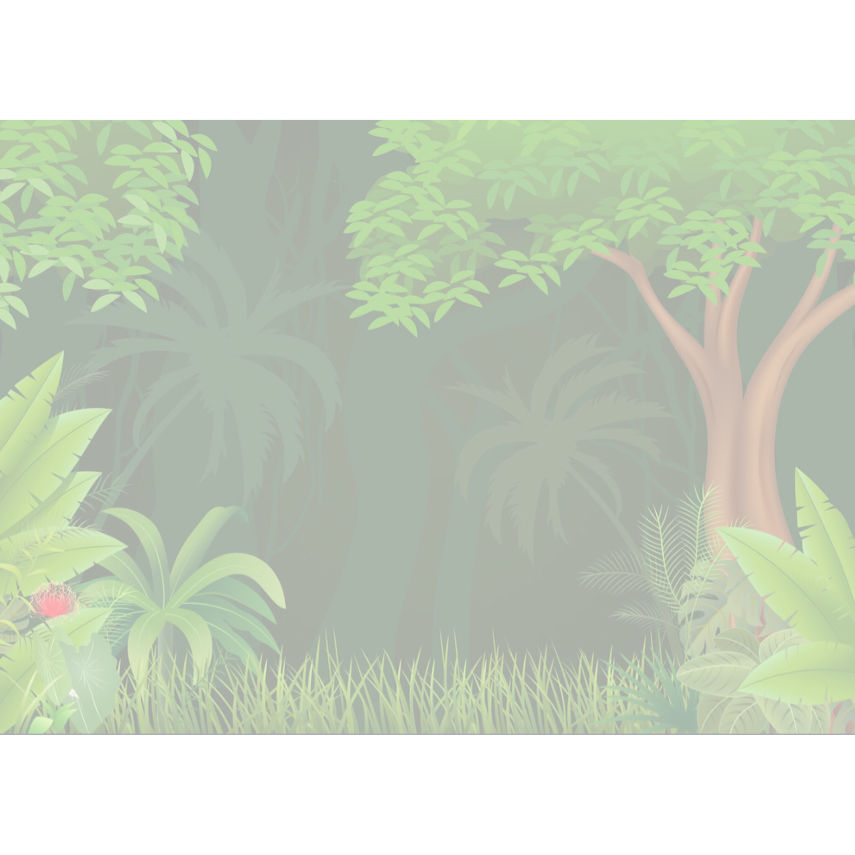
Introduction
Hello children!
Today, we are going to explore about trees!
Let’s be explorers and find out more about trees in the nature environment!
Introduction – Task 1–Task 2– Evaluation– Conclusion– Credits

Slide 3
Tasks
Task 1:
Watch a video and read about one tree.
Do a simple quiz at the end to collect stars!
Introduction – Task 1–Task 2– Evaluation– Conclusion– Credits
Notes:
Read something be4 sharing with friends
Write a note(specific) wad u mean by caring for environment

Slide 4
Tasks
Task 2:
Write a note to your friend about how you can care for the environment
Introduction – Task 1–Task 2– Evaluation– Conclusion– Credits
Notes:
Read something be4 sharing with friends
Write a note(specific) wad u mean by caring for environment

Slide 5
Task 1: Step 1
Watch a video about common plants in Singapore
Click the trees!
Introduction –Task 1– Task 2– Evaluation– Conclusion– Credits

Slide 6
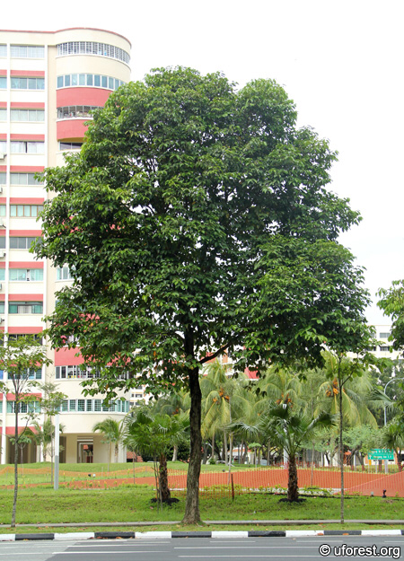
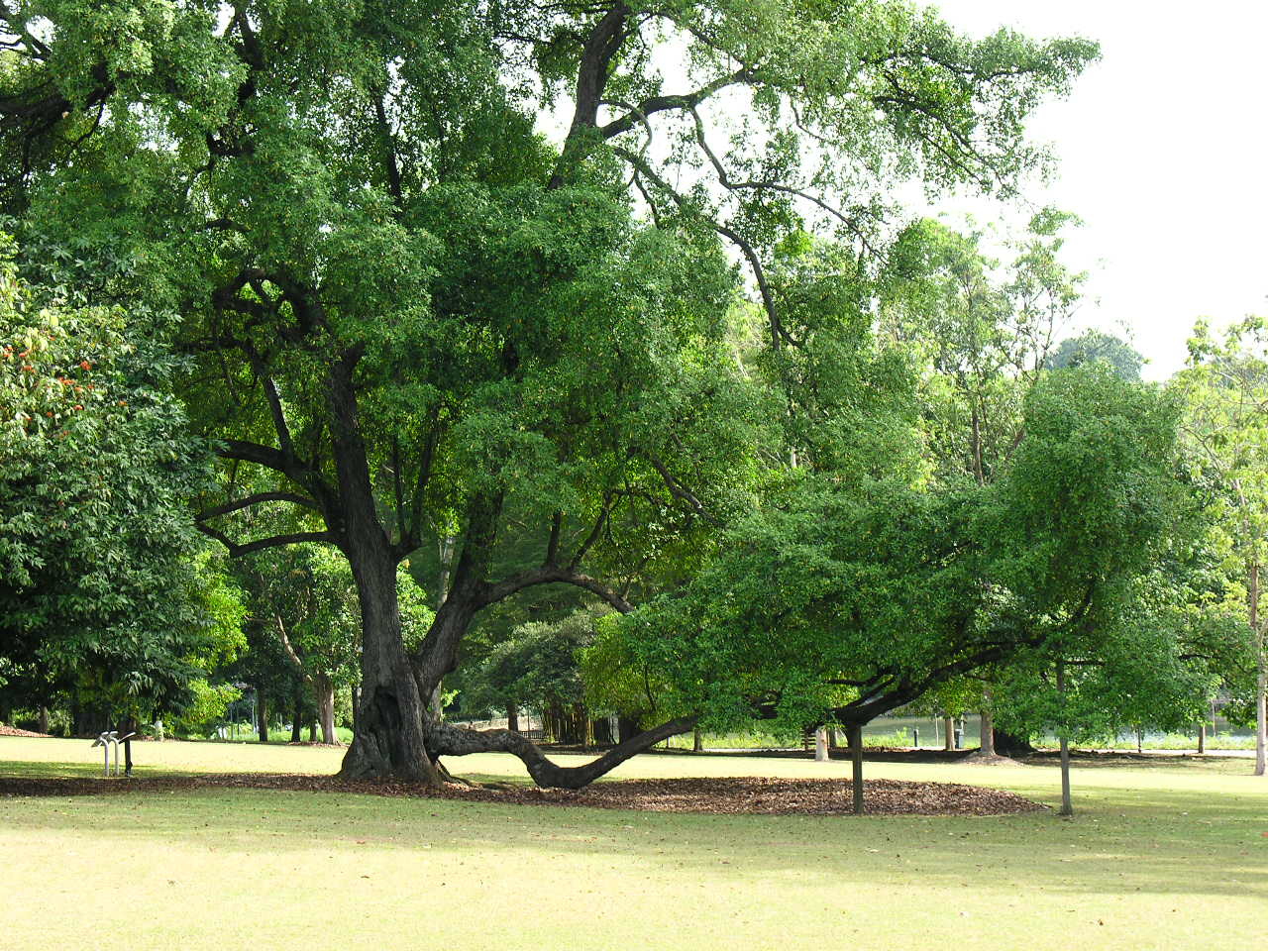
Task 1: Step 2
Choose one tree and click on it to do a puzzle to learn more!
Sea Apple Tree
Tembusu Tree
Introduction – Task 1– Task 2– Evaluation– Conclusion– Credits

Slide 7
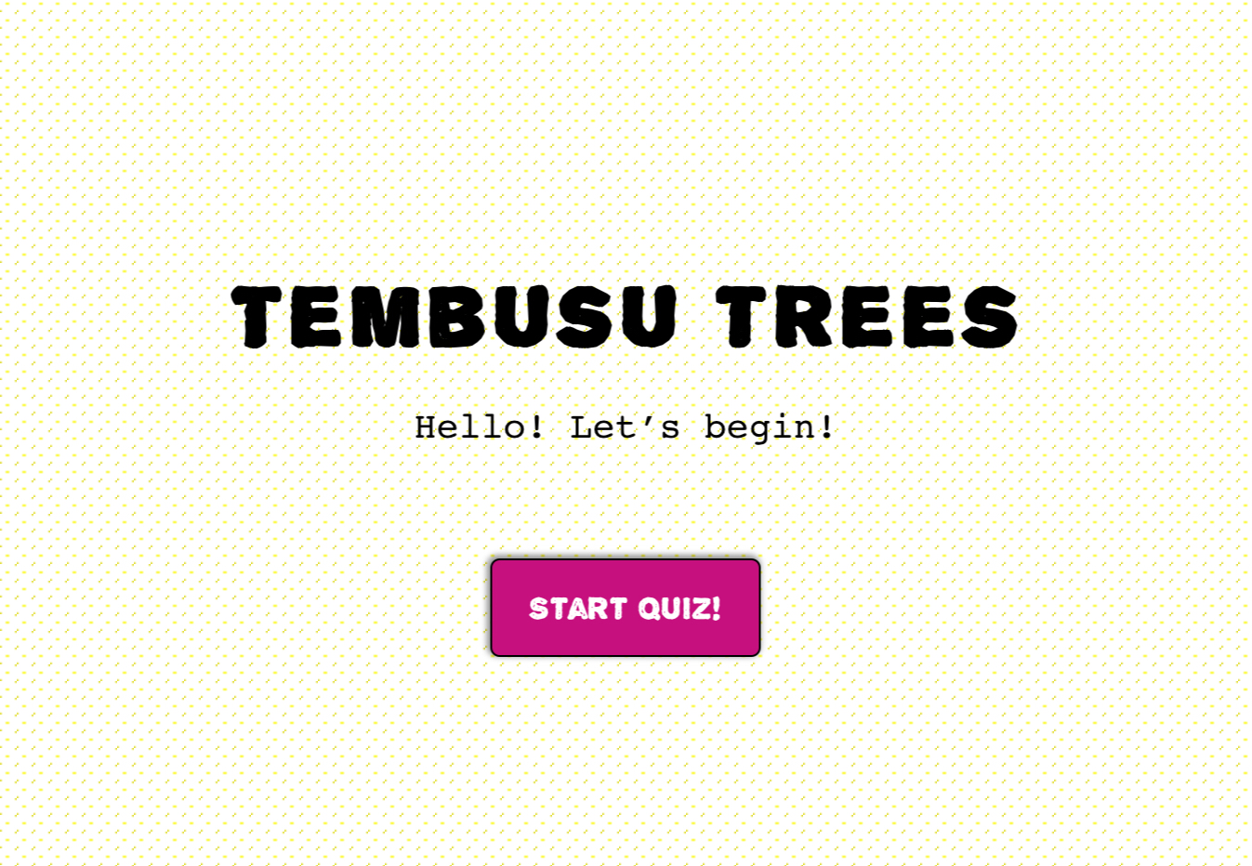
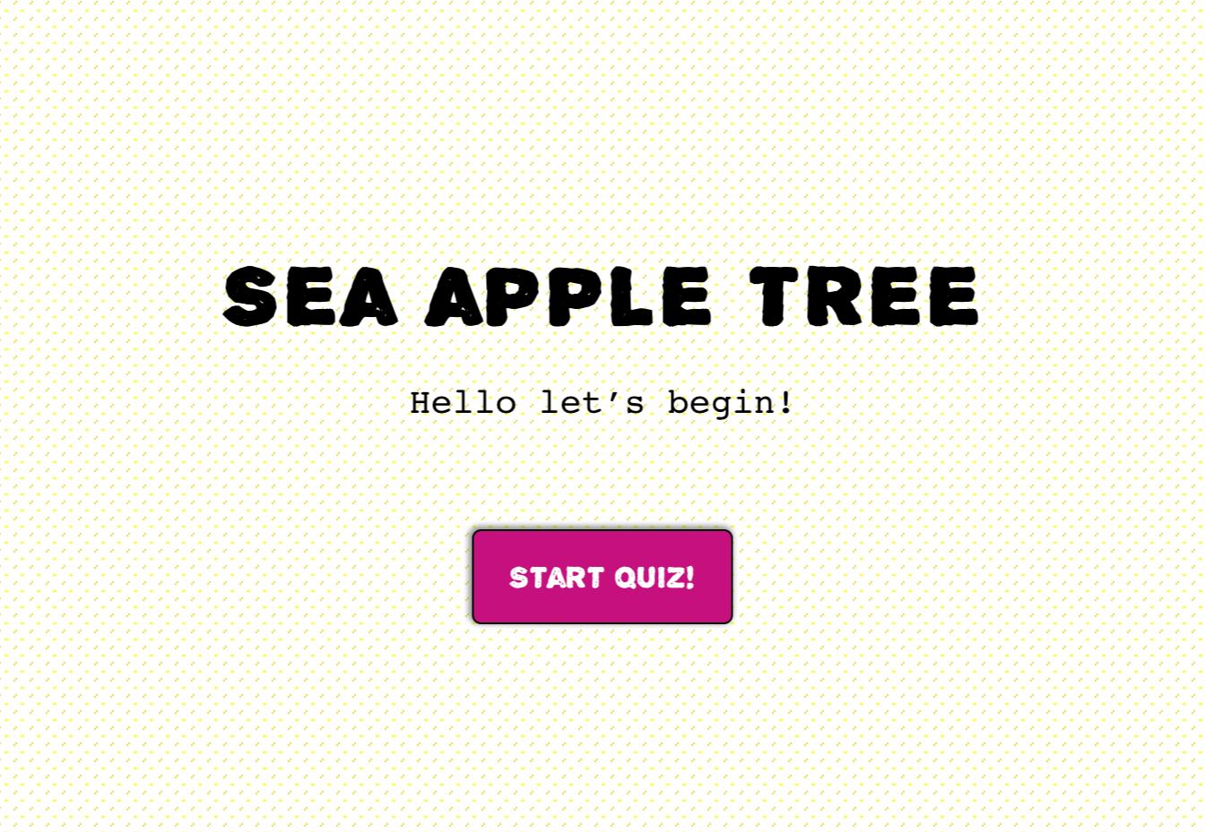
Task 1: Step 3
Do a quiz on the tree you read about! How many questions did you get correct?
Introduction – Task 1– Task 2– Evaluation– Conclusion– Credits

Slide 8
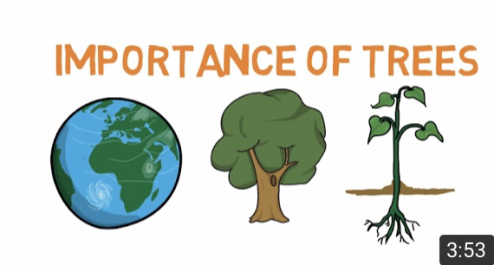
Task 2: Step 1
Watch a video on why trees are important
Click the picture!
Introduction – Task 1– Task 2– Evaluation– Conclusion– Credits

Slide 9
Task 2: Step 2
Do a puzzle to find out how to care for the environment!
Click the picture!
Introduction – Task 1– Task 2– Evaluation– Conclusion– Credits

Slide 10
Task 2: Step 3
Write a note to your friend about how you can care for the environment.
Exchange your note with another friend.
Introduction – Task 1– Task 2– Evaluation– Conclusion– Credits

Slide 11
Evaluation
Let’s see how many stars you will get! ☺️
Task 1 | Only watched the video | Only watched the video and completed the puzzle | Watched the video, completed the puzzle and quiz
Task 2 | Only watched video | Watched the video and completed the puzzle | Watched the video, completed the puzzle, wrote a note and exchanged it with a friend
Introduction – Task 1– Task 2– Evaluation– Conclusion– Credits

Slide 12
Conclusion
Well done! We have finished exploring the different trees! You are now an Environment Angel :)
Environment Angel
Introduction – Task 1– Task 2– Evaluation– Conclusion– Credits

Slide 13
Credits
Jigsaw Planet (n.d.). Sea Apple Tree. Retrieved from https://www.jigsawplanet.com/?rc=play&pid=2e083c544f4c
Jigsaw Planet (n.d.). Tembusu Tree. Retrieved from https://www.jigsawplanet.com/?rc=play&pid=320dd2e78756
Jigsaw Planet (n.d.). Ways to care for the environment. Retrieved from https://www.jigsawplanet.com/?rc=play&pid=2e083c544f4c
National Parks Board (2015, May 20). All About Our Trees: Common Trees in Singapore [Video file]. Retrieved from https://youtu.be/r3O0V5qkgPI
National Parks (n.d.). Know 10 Trees in Singapore! Tembusu [PDF File]. https://www.nparks.gov.sg/-/media/nparks-real-content/learning/teaching-and-learning-resources/posters/know-10-trees/6-know-10-trees-tembusu-final-pdf.pdf
National Parks (n.d.). Know 10 Trees in Singapore! Sea Apple [PDF File]. Retrieved from https://www.nparks.gov.sg/-/media/nparks-real-content/learning/teaching-and-learning-resources/posters/know-10-trees/7-know-10-trees--sea-apple-final-pdf.PDF
National Parks (n.d.). Trail Etiquette [PDF File]. Retrieved from https://www.nparks.gov.sg/~/media/nparks-real-content/gardens-parks-and-nature/parks-and-nature-reserve/windsor-nature-park/04-trailetiquetteextrarowr2pdf.PDF
Simply E-learn Kids (2017, February 4). Importance of trees – Facts about trees for kids – Why do we need trees – Simple E-learn kids [Video file]. Retrieved from https://youtu.be/PQwuog7_wmg
Weustenraad, D. (n.d.). Tembusu Trees. Retrieved from https://puzzel.org/en/quiz/play?p=-Ll5gBm4CeiYCXYR9hyj
Weustenraad, D. (n.d.). Sea Apple Tree. Retrieved from https://puzzel.org/en/quiz/play?p=-Ll5i7T1c2QdrRxRKMOz
Introduction – Task 1– Task 2– Evaluation– Conclusion– Credits

Slide 14
Photograph Credits
Flat Icons (n.d.). Rabbit free icon [Photograph]. Retrieved from https://www.flaticon.com/free-icon/rabbit_1998765#term=Rabbit&page=1&position=15
Freepik (n.d.). Bird free icon [Photograph]. Retrieved from https://www.flaticon.com/free-icon/bird_1373215
Freepik (n.d.). Businessman With Doubts free icon [Photograph]. Retrieved from https://www.flaticon.com/free-icon/businessman-with-doubts_49144#term=Question&page=1&position=31
Freepik (n.d.). Leaf free icon [Photograph]. Retrieved from https://www.flaticon.com/free-icon/leaf_941543
Freepik (n.d.). Love free icon [Photograph]. Retrieved from https://www.flaticon.com/free-icon/love_1530830#term=Love%20plant&page=1&position=2
Freepik (n.d.). Meeting free icon [Photograph]. Retrieved from https://www.flaticon.com/free-icon/meeting_1006542#term=communication&page=2&position=53
Freepik (n.d.). Plant free icon [Photograph]. Retrieved from https://www.flaticon.com/free-icon/plant_877627
Freepik (n.d.). Tree free icon [Photograph]. Retrieved from https://www.flaticon.com/free-icon/tree_489969
Icongeek26 (n.d.). Angel free icon [Photograph]. Retrieved from https://www.flaticon.com/free-icon/angel_1958036
Memoangeles (n.d.). Explorer kids [Photograph]. Retrieved from http://tiny.cc/cvmtaz
Photo3idea_studio (n.d.). Robin free icon [Photograph]. Retrieved from https://www.flaticon.com/free-icon/robin_1965103#term=Birds&page=1&position=21
Prettycons (n.d.). Forest free icon [Photograph]. Retrieved from https://www.flaticon.com/free-icon/leaf_941543
Tigatelu (n.d.). Cartoon of beautiful natural background vector image [Photograph]. Retrieved from https://www.vectorstock.com/royalty-free-vector/cartoon-of-beautiful-natural-background-vector-8233924
Twitter (n.d.). Rabbit free icon [Photograph]. Retrieved from https://www.flaticon.com/free-icon/rabbit_578370#term=Rabbit&page=1&position=47
Smashicons (n.d.). Star free icon [Photograph]. Retrieved from https://www.flaticon.com/free-icon/star_148839#term=Star&page=1&position=4
Srip (n.d.). Document free icon [Photograph]. Retrieved from https://www.flaticon.com/search?word=Paper%20pen
Urban Forest (n.d.). Syzygium grande [Photograph]. Retrieved from http://uforest.org/Species/S/Syzygium_grande.php
VectorStock (n.d). Cartoon Fantasy forest vector image. [Photograph]. Retrieved from https://images.app.goo.gl/ZLDYfymWHyUSnopv7
Wikipedia (n.d.). Tembusu [Photograph]. Retrieved from https://images.app.goo.gl/KoJ86CdLX73R2K556
Ylivdesign (n.d.). Hands holding globe earth icon cartoon style [Photograph]. Retrieved from http://tiny.cc/1lrsaz
Introduction – Task 1– Task 2– Evaluation– Conclusion– Credits

Slide 15
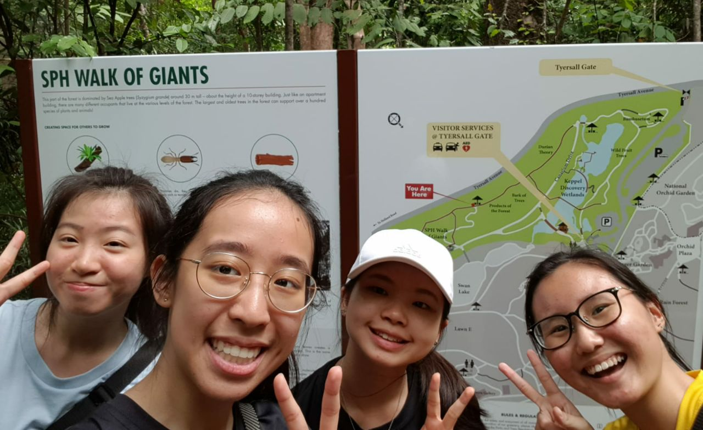
Group Members
Serene Heng
Gi Gi Png
Rena Sng
Ang Sze Min

